Slide 1
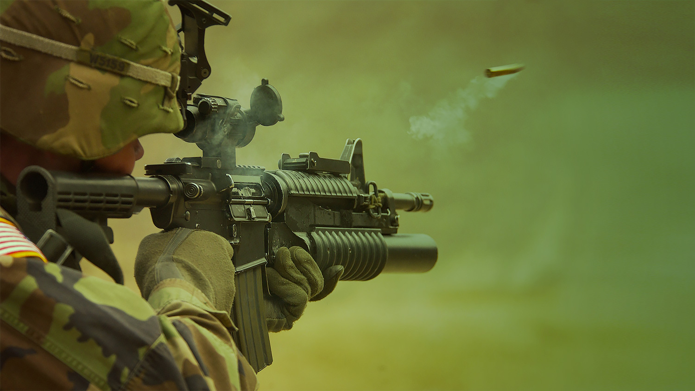

AI Based Small Arms Firing Score Evaluator
Developed By
Akash Jha (33671023009)
Rupal Mandal (33671023004)
Nitesh Pradhan (33671023003)
Souradipta Bagchi (33671023035)
Department - MCA
Semester - 3rd Semester
Year of Submission - 2025
Under the guidance of
Professor Dr. Tumpa Banerjee

Slide 2

Problem Statement
Current target practice in the Indian Army is manual and monotonous, requiring personnel to run and check targets hits after each round.
This method is time-consuming and also the pre-existing systems costs upto Rs. 4.5 Cr and therefore they are not suited for employment at Unit level.
Therefore, an automated target evaluation system is needed to:
Provide instant feedback
Generate detailed performance reports
Track progress over time
Our system uses predefined criteria such as accuracy, distance from the target, and consistency across multiple shots .

Slide 3
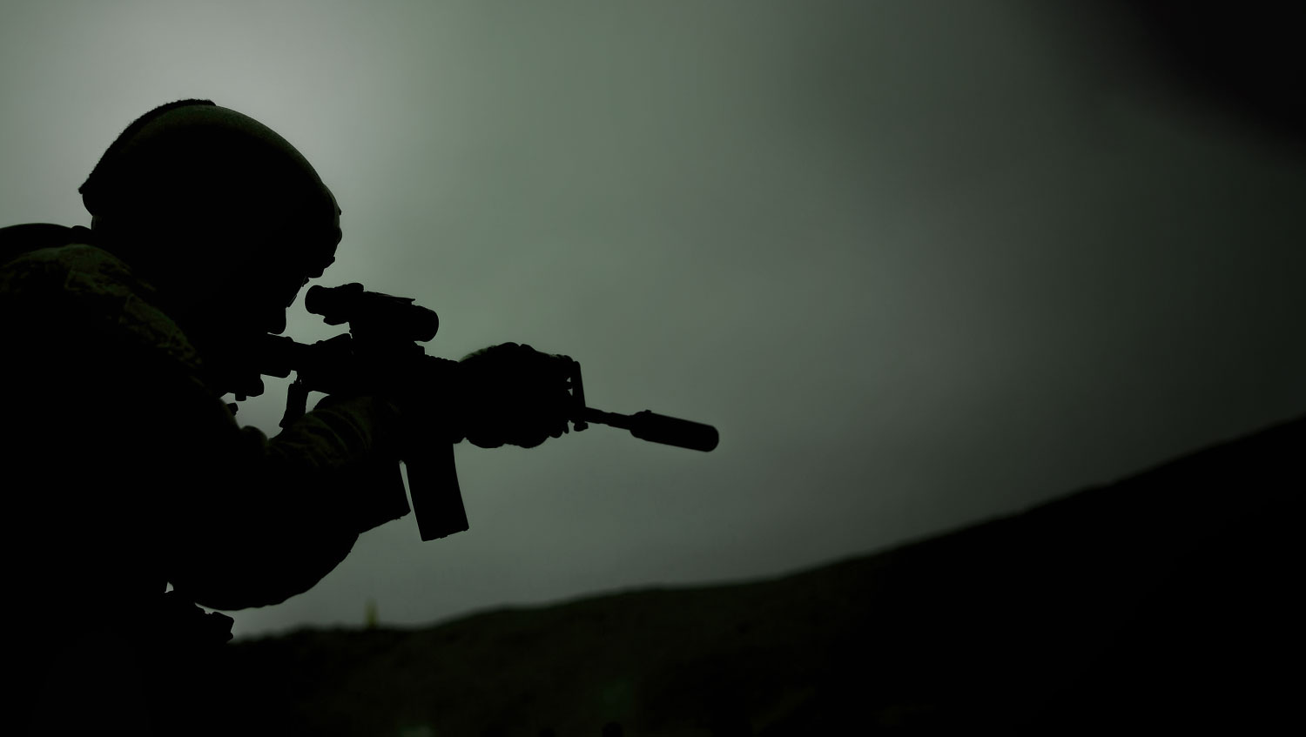






Technologies Used In Our Project
Machine Learning
Python
Flask
OpenCV
Ultralytics
My SQL

Slide 4
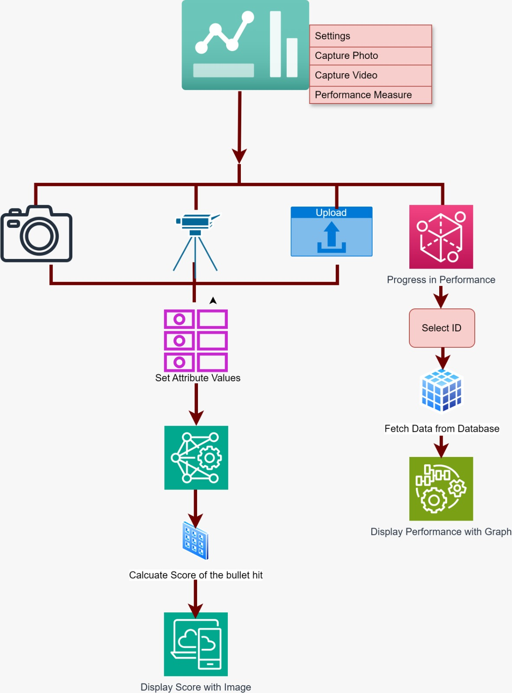
Control Flow Diagram

Slide 5
Features
Evaluating performance of each shooter
Live score board for each shooter
Capture photos from mobile phone
Browse Option for uploading photos and videos
Components
One Server/PC for the trainer
Eight Cameras , each near the target
Eight Camera Stands
Eight mobile phones , each near individual firer
Cables and Connectors

Slide 6
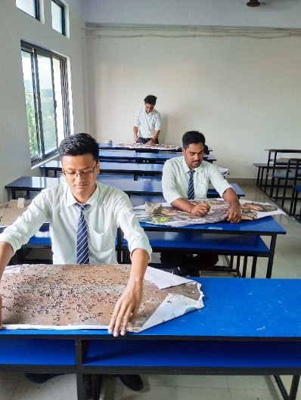
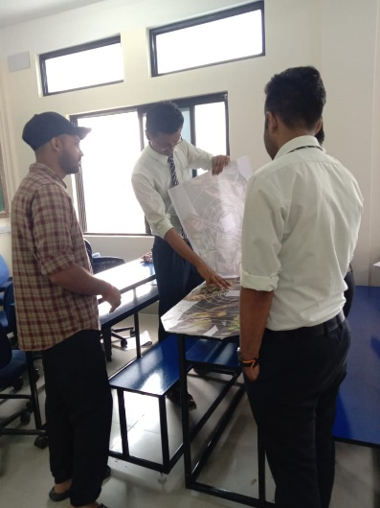
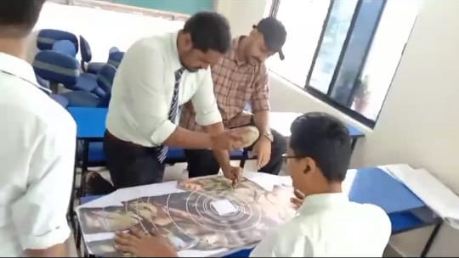
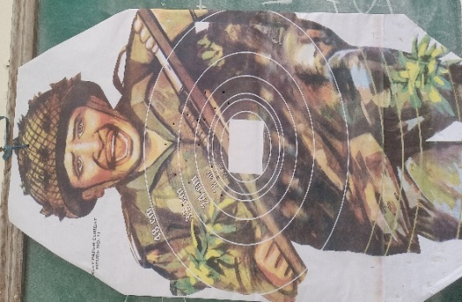
Create Dataset
1. Make holes manually like bullet hit
2. Take images of the hardcopy of figure 11

Slide 7
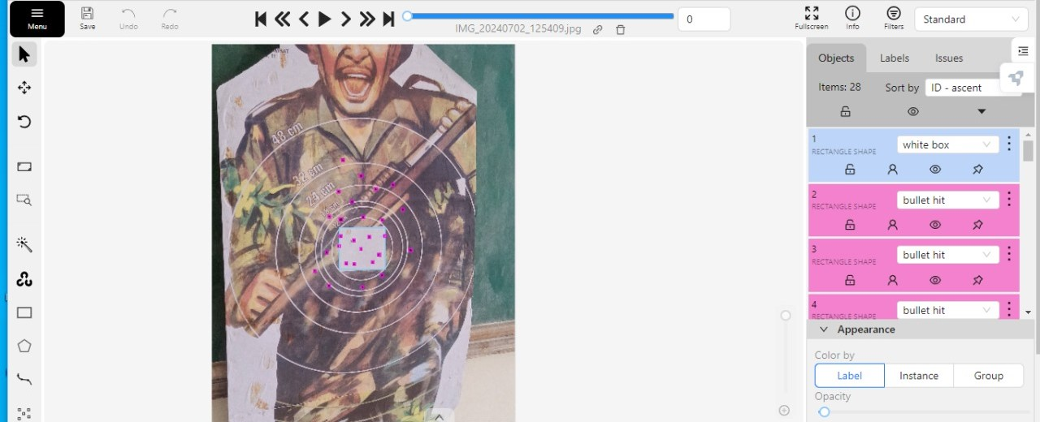
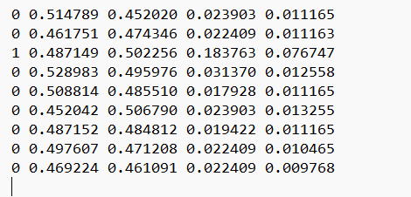
Create Dataset
3. Annotate the bounding box:
Annotation involves labeling the images with specific information, such as the location of bullet impacts, distance from the target, and whether the shot hit the center or the surrounding areas . CVAT was used for this purpose.
Two classes were created :
Class 0: This denotes "bullet hit" data, meaning the coordinates or measurements following it represent specific attributes (e.g., distances or bounding box values) related to detected bullet hits.
Class 1: This represents "white box" data (target), where the subsequent values pertain to the detected target or its position.

Slide 8
Create Dataset
After following all the previously mentioned steps, the dataset was divided into training and testing subsets and was split into 80:20 ratio, where the larger portion was used for training and the smaller one is for testing.
Dataset | Number of images
Total Number of images after Augmentation | 455
Total Number of images before Augmentation | 245
Number of images in Training | 364
Number of images in Testing | 91

Slide 9
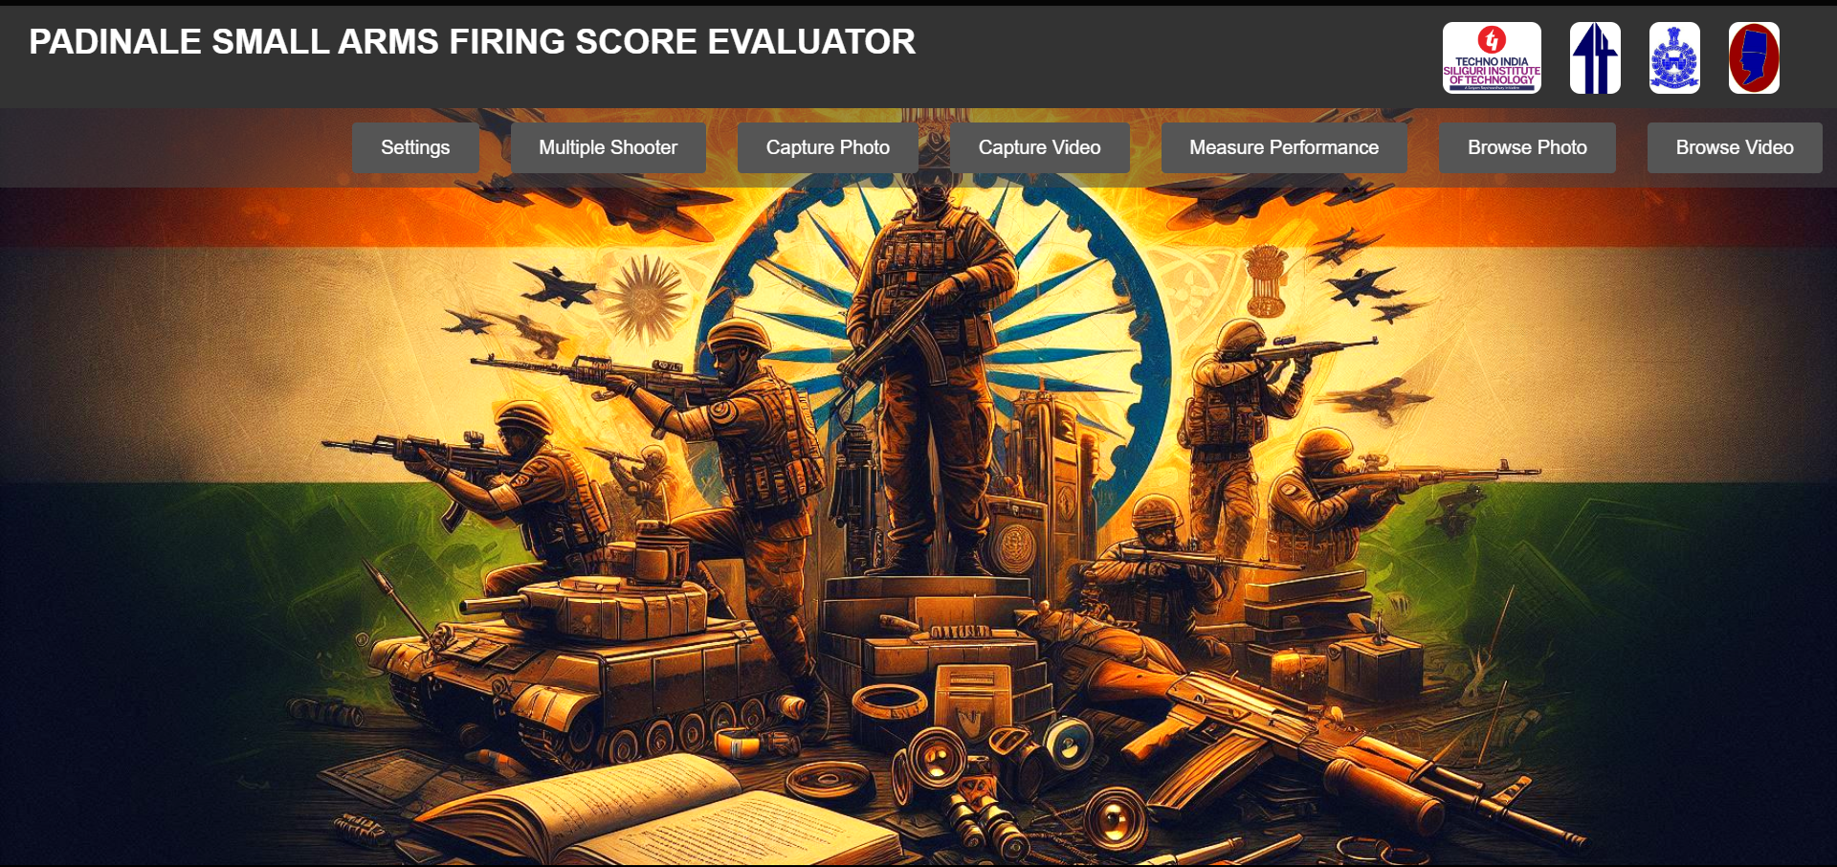

Slide 10
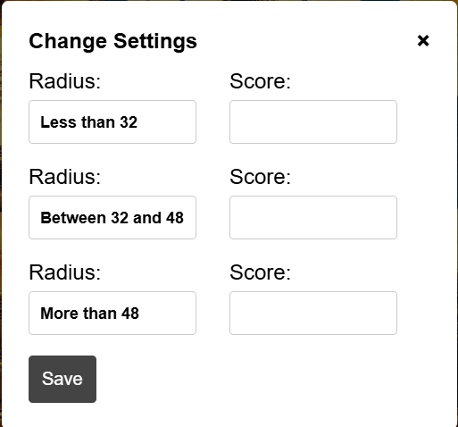
On clicking Settings

Slide 11
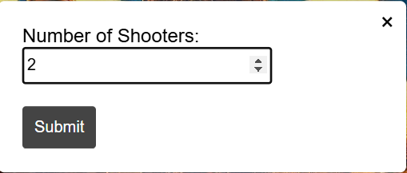
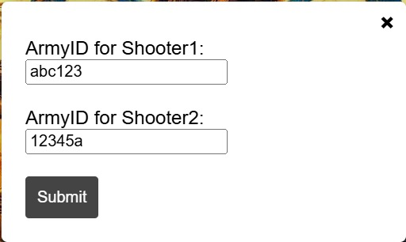
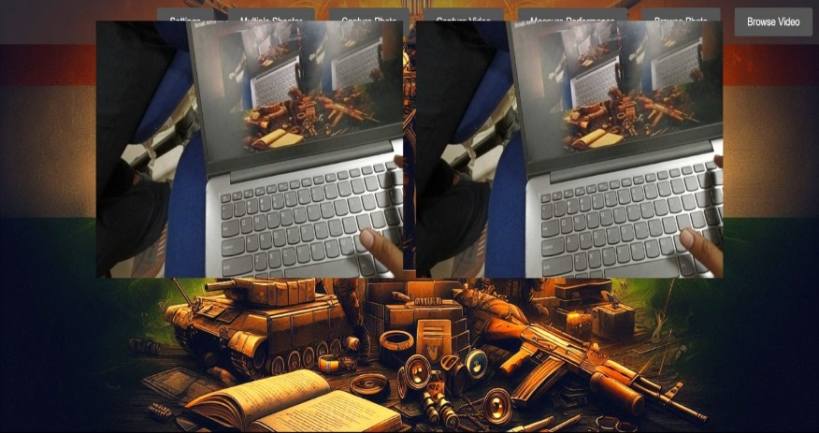

Slide 12
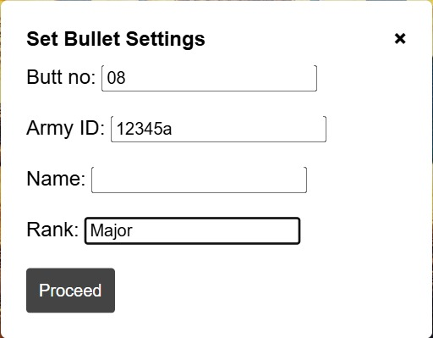
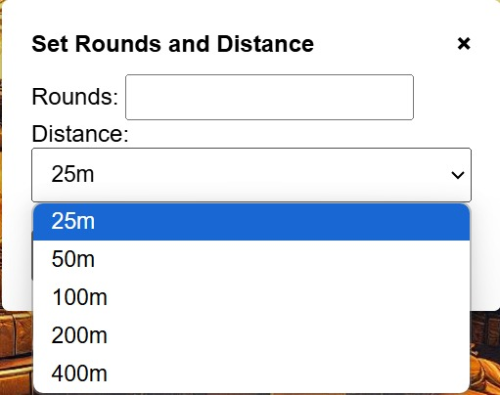
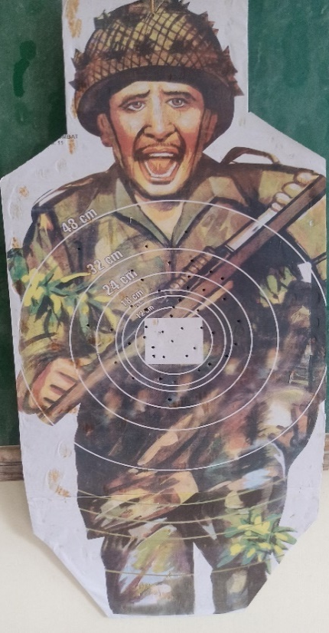

Slide 13
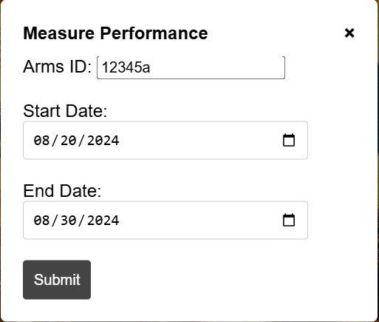
On clicking Measure Performance

Slide 14
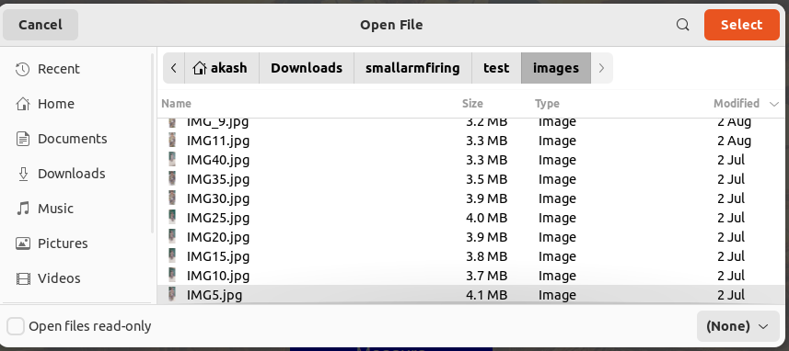
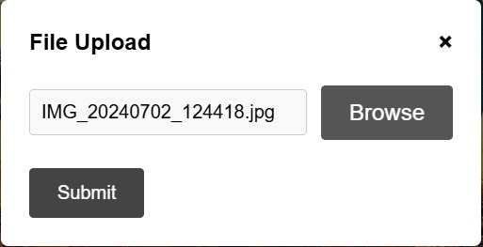

Slide 15
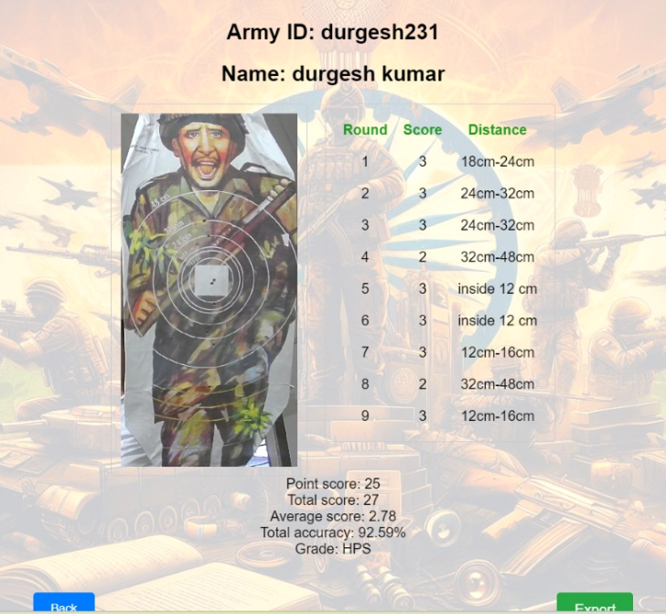
Output

Slide 16
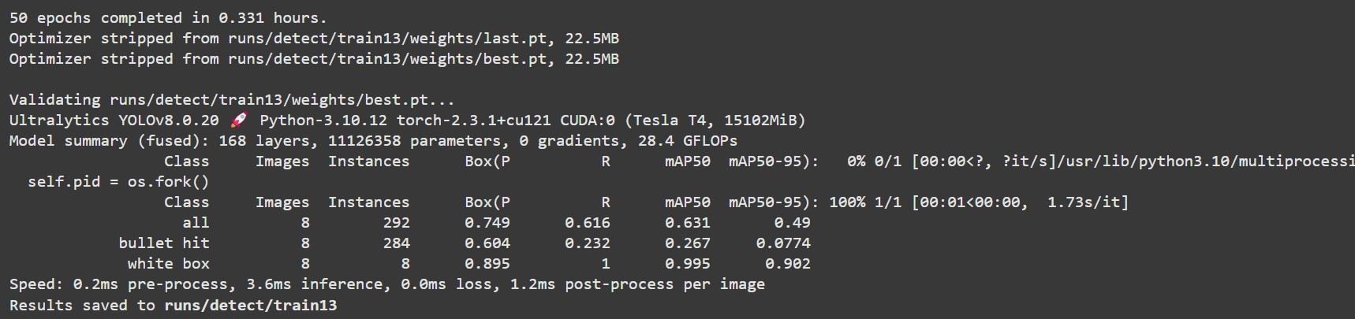
Overall Project Output
Model accuracy:
74.9% of predicted boxes are correct.
60.4% precision for bullet hit class.
89.5% precision for white box class.
mAP50 (mean Average Precision at IoU=0.5):
63.1% overall mAP50.
26.7% mAP50 for bullet hit class.
99.5% mAP50 for white box class.

Slide 17
Estimated Project Cost
Category | Estimated cost(Rs.)
Server | Rs.90,000
Cameras(8 units) | Rs.64,000
Camera Stands(8 units) | Rs.8,000
Mobile Phones(8 units) | Rs.1,20,000
Cables & Connectors | Rs.12,000
Additional Costs (UPS, Routers) | Rs.51,000
Total | Rs.3,45,000
Estimated Implementation Cost :
3.50 Lakhs/unit approximate
Estimated Prototype Production Cost : Volunteered by MCA Department, S I T

Slide 18
Thank You !

